Slide 1
An Introduction to Generalized Linear Models
Evan M. Adams and Beth Ross
8/5 – 8/6/2021

Slide 2
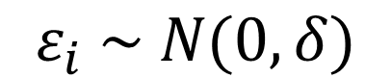
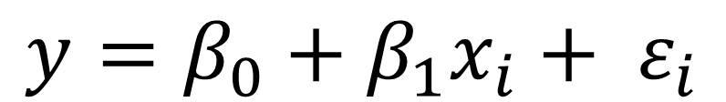
What are GLMs?
$$y=β_{0}+β_{1}x_{i}+ ε_{i}$$
Two Main Components
Linear regression
Mean-variance assumption
$$ε_{i} \sim N(0, δ)$$

Slide 3
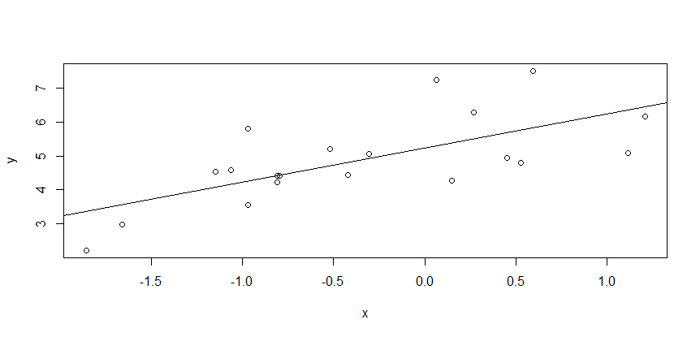
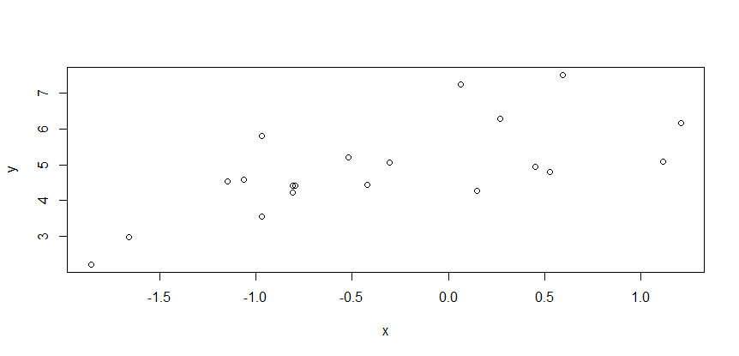
Linear Regression
β
α
α

Slide 4
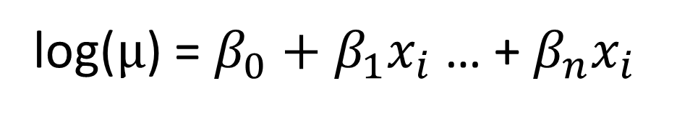
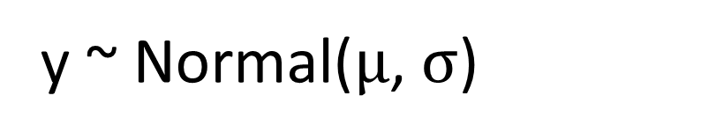
Mean-variance assumption
The assumption of what probability distribution best describes the response variable
And thus the distribution of the model residuals
This assumption is then modulated by a link function to give additional flexibility
y ~ Normal($μ$, $σ$)
log($μ$) = $β_{0}+β_{1}x_{i}$ … + $β_{n}x_{i}$

Slide 5
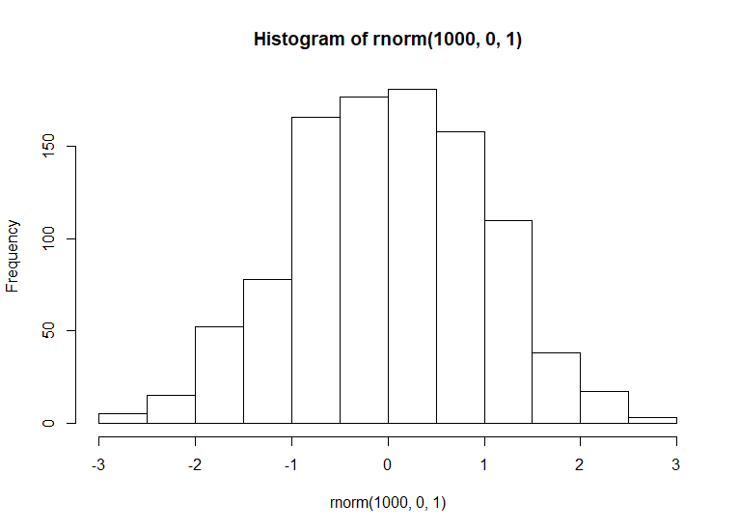

Slide 6
Mean-variance assumption
The assumption of what probability distribution best describes the response variable
This assumption is then modulated by a link function to give additional flexibility
y ~ Normal($μ$, $σ$)
log($μ$) = $β_{0}+β_{1}x_{i}$ … + $β_{n}x_{i}$

Slide 7
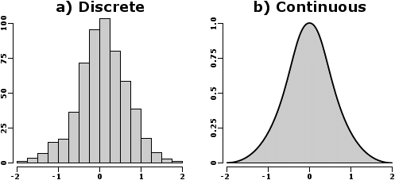
Probability Distributions
Descriptions of mean-variance relationships
PDs describe uncertainty that we have in linear models
We assume that the chosen PD adequately represents the response variable
That’s means we have to check our assumptions
https://miro.medium.com/max/497/1*c2ylMCItL1XG6O3mGhjzng.png

Slide 8
Key Assumptions of the Technique
Response variable observations are independent
Residuals must be independent
Large-sample approximations of normality hold true

Slide 9
What should we use these models?
Flexible to different types of response variables
Continuous, discrete, etc.
By pairing different link functions and mean-variance relationships we can model a lot of different data sets effectively
We get to use maximum likelihood estimators and all that comes with that
Mainly confidence intervals and goodness-of-fit tests
They are computational fast and provide stable responses across a variety of scenarios

Slide 10
When should we avoid such models?
When responses are not independent
Though see Generalized Liner Mixed Models in our discussion later
When assumptions of linear relationships between independent and dependent variables do not hold
Though here are ways of rescaling independent variables or specifying the linear models that can help you here
When more complex models are needed to model process variation in your response
When more complex models are needed to describe the mean-variance relationship in your response

Slide 11
But what happens when you try to model count data with a GLM?

Slide 12

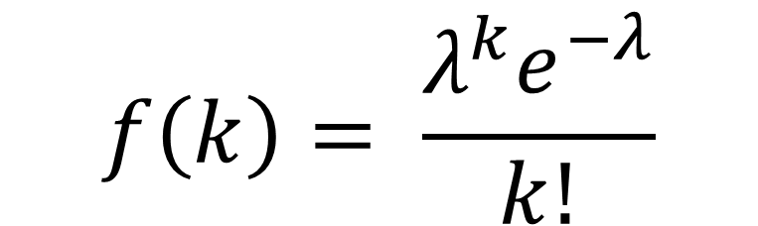
The Poisson distribution
The classic distribution for handling count data
The main parameter is intensity (λ)
Key limitation: the mean is equal to variance (so lambda accounts for both)
On the upside, there is only one parameter that we need to estimate…
$$f\left(k\right)= \frac{λ^{k}e^{−λ}}{k!}$$
PMF

Slide 13
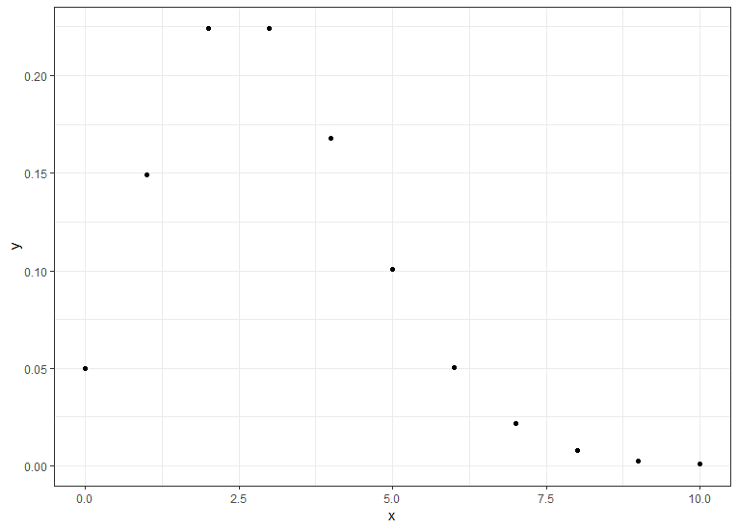
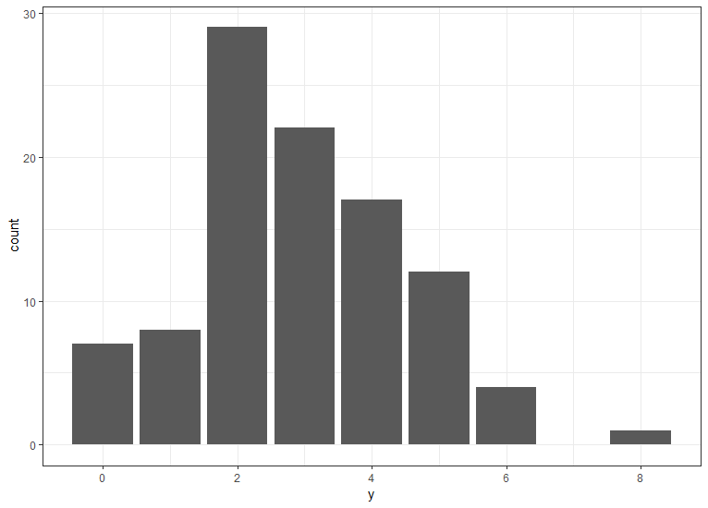
The Poisson distribution
PMF
Random Draw from the PMF

Slide 14
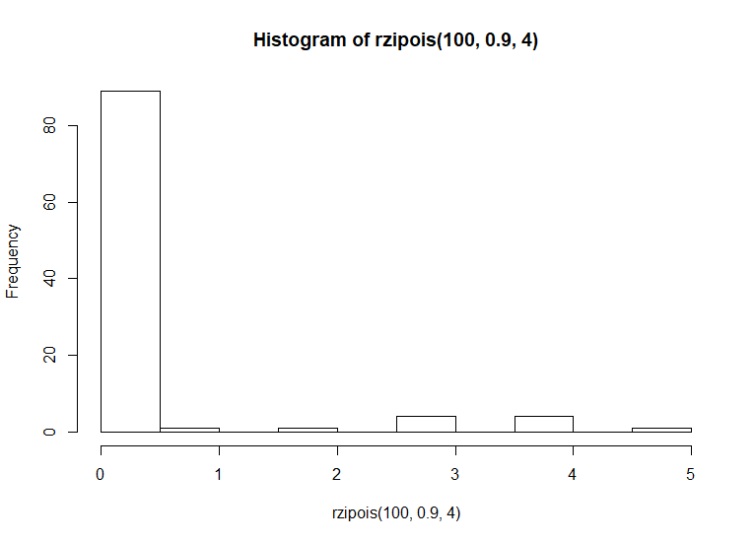
Zero-inflated Poisson Distribution

Slide 15
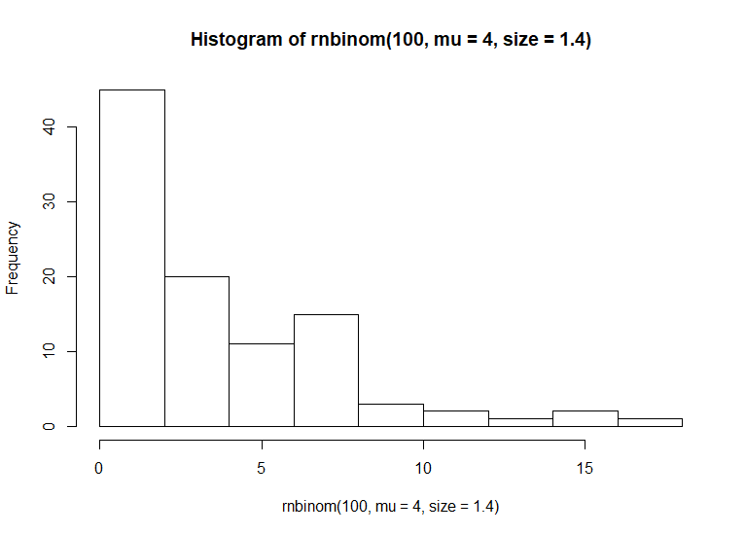
Negative Binomial Distribution

Slide 16
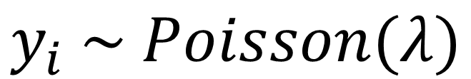

Generalized linear model for counts
Link function
$$log⁡(y_{i})=β_{0}+β_{1}x_{i}$$
$$y_{i} \sim Poisson(λ)$$
The same linear equation as with the Gaussian formulation but model uncertainty is estimated differently
Poisson distributions only have one parameter to describe the mean-variance relationship so you don’t need the additional term in the model

Slide 17
Assessing Goodness-of-Fit
Quantile-Quantile Plots
Compares the quantiles of the data and predicted values from the model
If the model is good, you should see a clean linear relationship (slope = 1)
This shows you that your model predicts reasonable values across the range of responses
Fitted-Residual Plots
Similar to QQ Plots, but here we want to see no clear relationship
If there is a relationship, it implies that uncertainty is not random across predicted values and model assumptions are violated
Pseudo R²
A value between 0-1 to describes how much variation your models fits vs. a null model
A relative assessment of fit and that doesn’t account for poor fit in the null

Slide 18
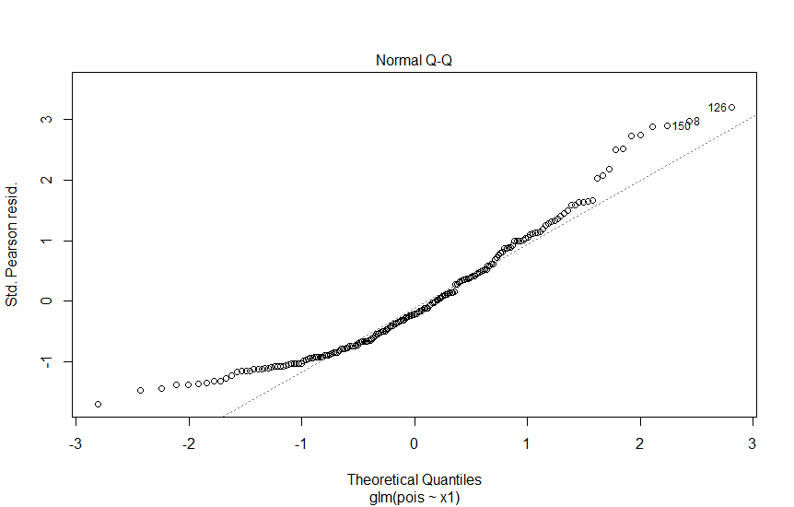
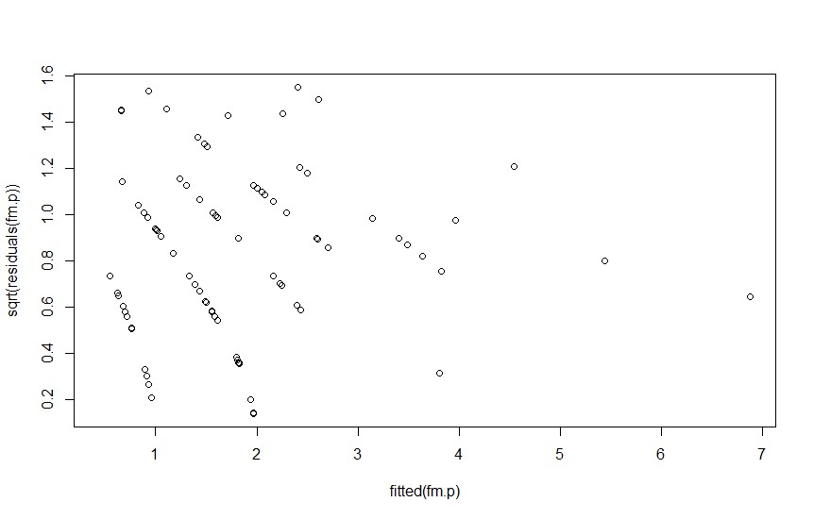
Example where fit is good

Slide 19
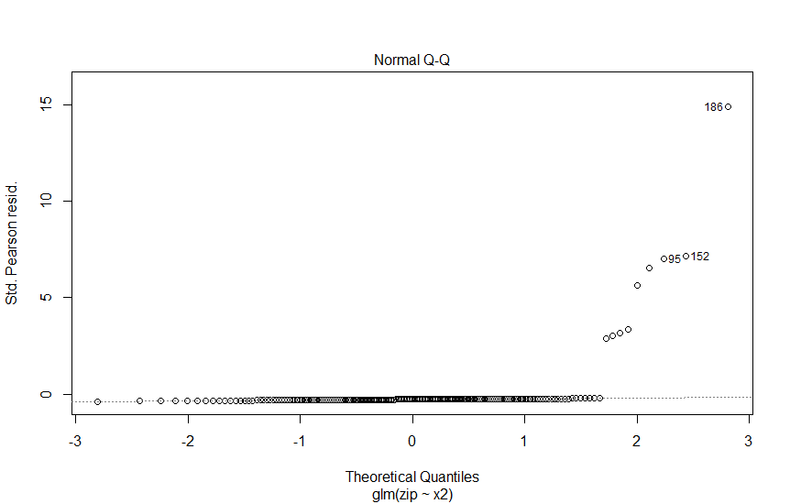
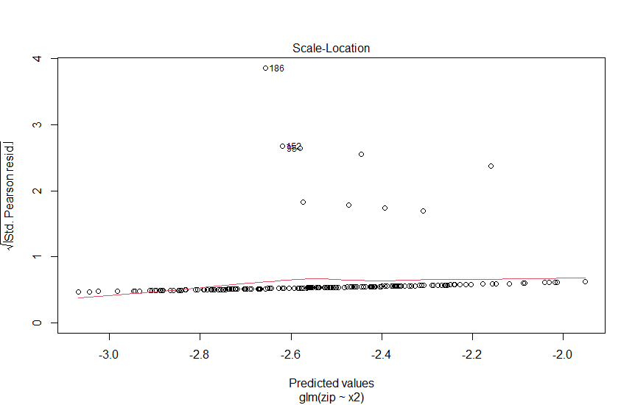
Example where fit is poor

Slide 20
Best Practices for Conducting Poisson GLMs
Always assess model fit
Be cautious of the distribution you choose to model count data
Visualize your model predictions with your data, make sure that they look similar (and use graphs and statistical tests to help you)
Design your model selection process to your goals
Exploratory models can test many variables, but hypothesis-testing should be more focused
Ensure the variables you include are not correlated with one another
Visualize your results always with model predictions and uncertainty
Use confidence and prediction intervals to describe your modeled uncertainty in effects
Remember that link functions are prevalent in these GLMs
Poisson distributions require a log link
Zero-inflated distributions use a logit link
Parameter values are often link transformed state, make sure to understand what they are in

Slide 21
What happens when the Poisson distribution doesn’t work well?
Look at your data and determine if a Poisson distribution is appropriate
Are there lots of zeroes? Are there extremely large values? Then it probably doesn’t model your variation very well.
Consider if you are leaving out factors in your model that could help explain large amounts of variation
The large number of zeros could be due to an unmodeled effect
Consider if there is another source of bias in your data
E.g., observers aren’t detecting something all the time and you need to model that process jointly with the counts themselves

Slide 22

Example: Using birds as an tool for monitoring tick relative abundance

